Slide 1


Types of Frameworks –
BDD: Cucumber-JVM
Sergiy Kaliberda
March 18, 2016

Slide 2


LET’S BECOME FAMILIAR …
Sergiy Kaliberda
Email: Sergiy_Kaliberda@epam.com
Skype: kaliberda_s
Senior Software Test Automation Engineer
About 5 years in Test Automation
Expertise:
UI test Automation
Web Services
Performance testing
BDD

Slide 3

Agenda
BDD evolution
BDD benefits
BDD in Details
BDD in Action

Slide 4
BDD evolution of TDD
Unit test
Test code automatically

Slide 5
BDD evolution of TDD
Unit test
TDD
Write test first
Test code automatically

Slide 6
BDD evolution of TDD
Unit test
TDD
BDD
Dan North
Write test first
Test code automatically

Slide 7
BDD approach
BDD(behavior-driven development) - is a set of software engineering practices designed to help teams build and deliver more valuable, higher quality software faster. It draws on Agile and lean practices including, in particular, Test-Driven Development (TDD) and Domain-Driven Design (DDD).
BDD isn’t a software development methodology in its own right. It’s not a replacement
for Scrum, XP, Kanban, RUP, or whatever methodology you’re currently using.
MAIN GOAL: EXECUTABLE SPECIFICATION

Slide 8
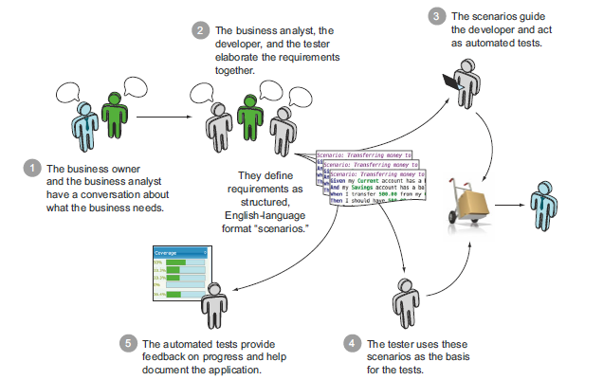
BDD process

Slide 9

Pros:
1
Anyone can get actual state of development progress
2
Nice and readable reports
3
Requirements, test cases, automated tests are up to date.
4
Less time for application development.
5
Separated logic of tests and implementation.
6
Easy to use for manual testing.

Slide 10
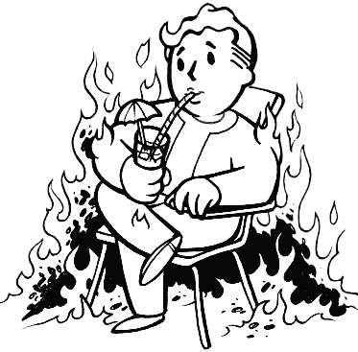
Cons:
1
Do not work in case only testers are involved.
2
Impossible to make verifications in the body of test case it’s possible only in the THEN section.
3
Do not work in case there are too much complex test data.
4
Hard to refactor tests.
5
Should be created and maintained keywords dictionary.
6
Possible code duplication in big teams.

Slide 11
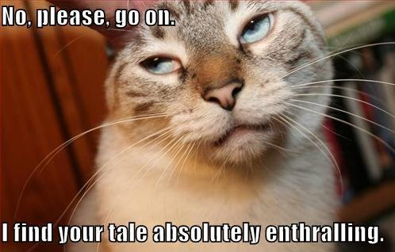

Slide 12
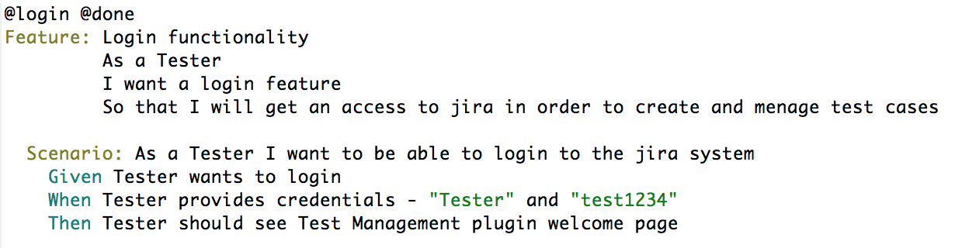
Feature example

Slide 13
Gherkin syntax
Feature
Scenario 1
…
Scenario 2
Scenario n
Given-When-Then
Given-When-Then
Something valuable for customers
Scenarios which describe feature in details

Slide 14
Feature structure
Feature
As a [some role here]
I want [some feature here]
So that [benefit of the feature here]
Specifies role of stakeholder
Describes important feature for stakeholder
Describe why this feature is valuable

Slide 15
Scenario structure (acceptance criteria)
Scenario
Given
When
Then
Specifies System Under Test (SUT) initial state
Specifies actions applied on SUT
Specifies one or more assertions

Slide 16
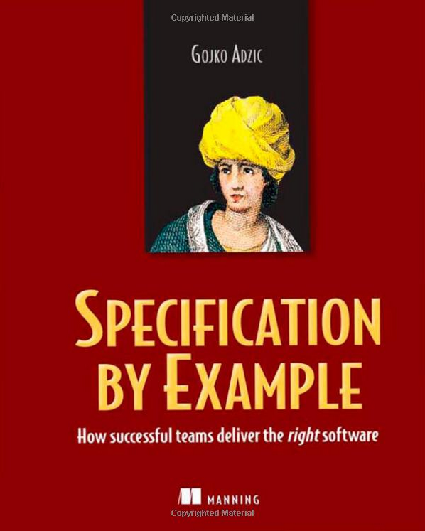
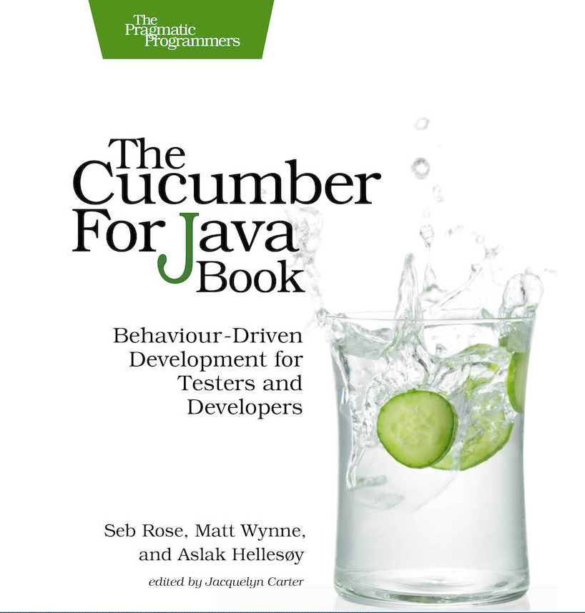

Books and Docs

Slide 17


Slide 18


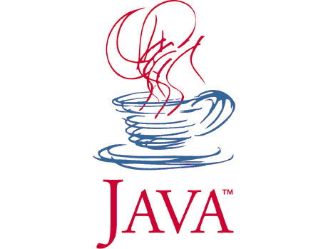
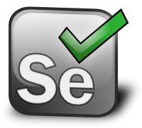

Tooling

Slide 19

Cucumber-JVM
Big community
Cross platform
jUnit integration
Table using
Data Driven Testing
https://github.com/cucumber/cucumber-jvm/
Aslak Hellesøy

Slide 20
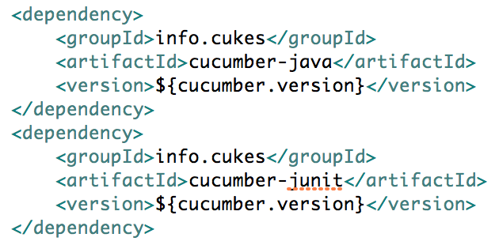
Adding to MVN project

Slide 21
Feature example

Slide 22
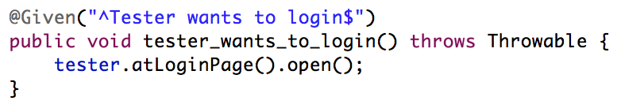
Behavior functions

Slide 23
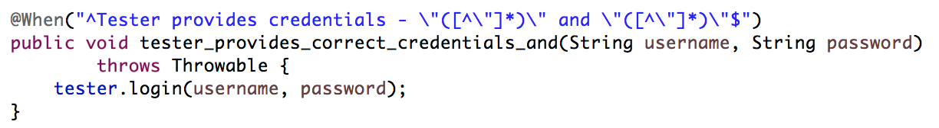
Strings

Slide 24
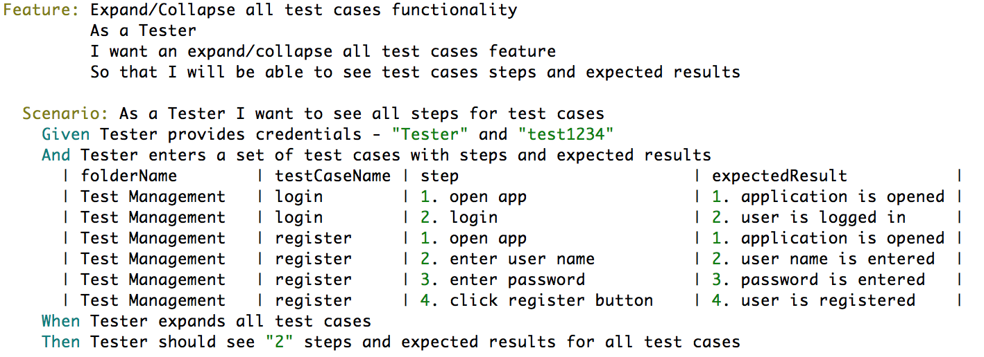
Gherkin tables

Slide 25
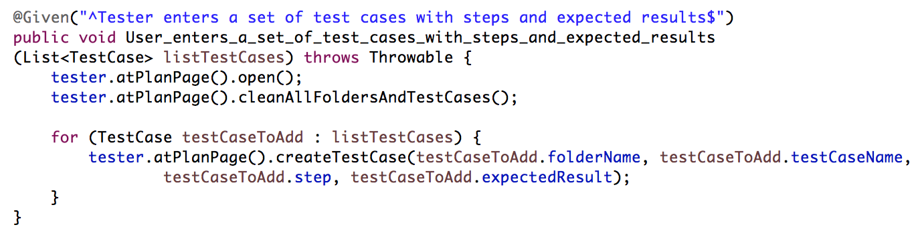
Gherkin tables – code mapping

Slide 26
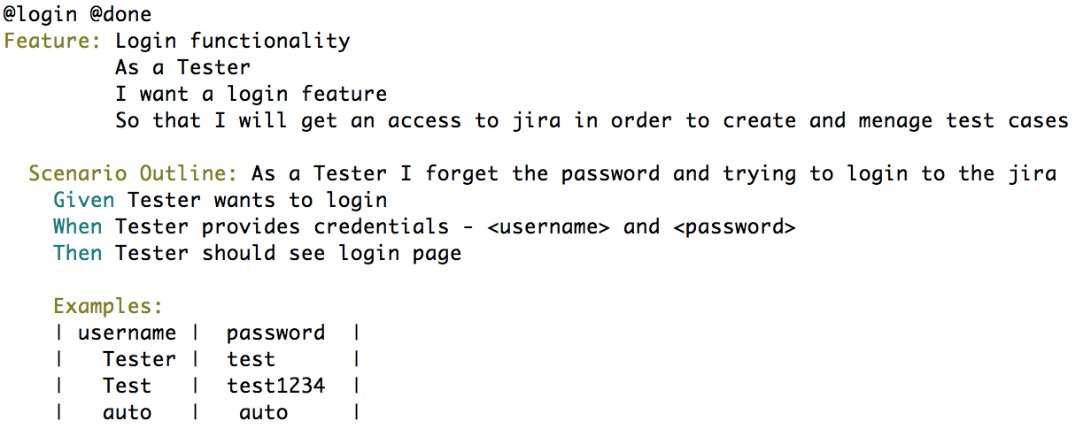
Data Driven

Slide 27
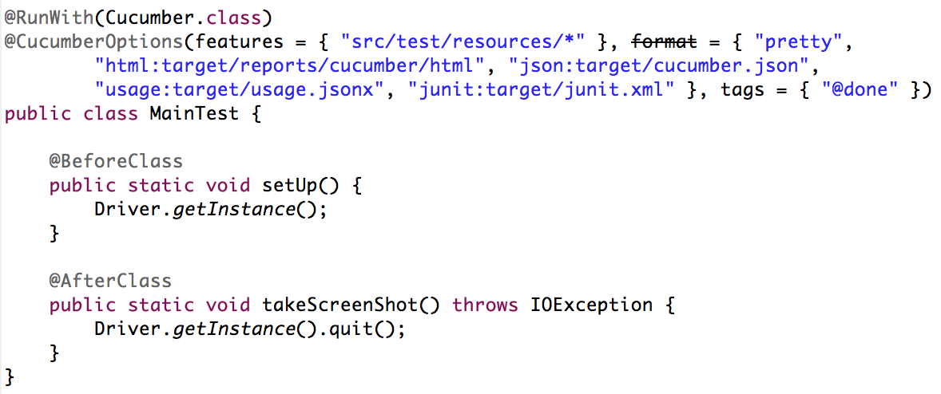
Run Options

Slide 28
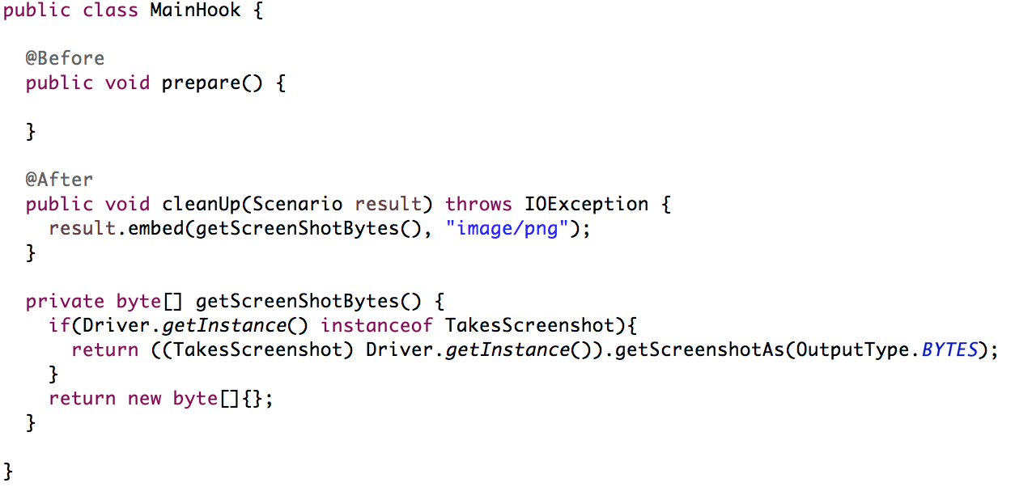
Hooks

Slide 29

Demo

Slide 30
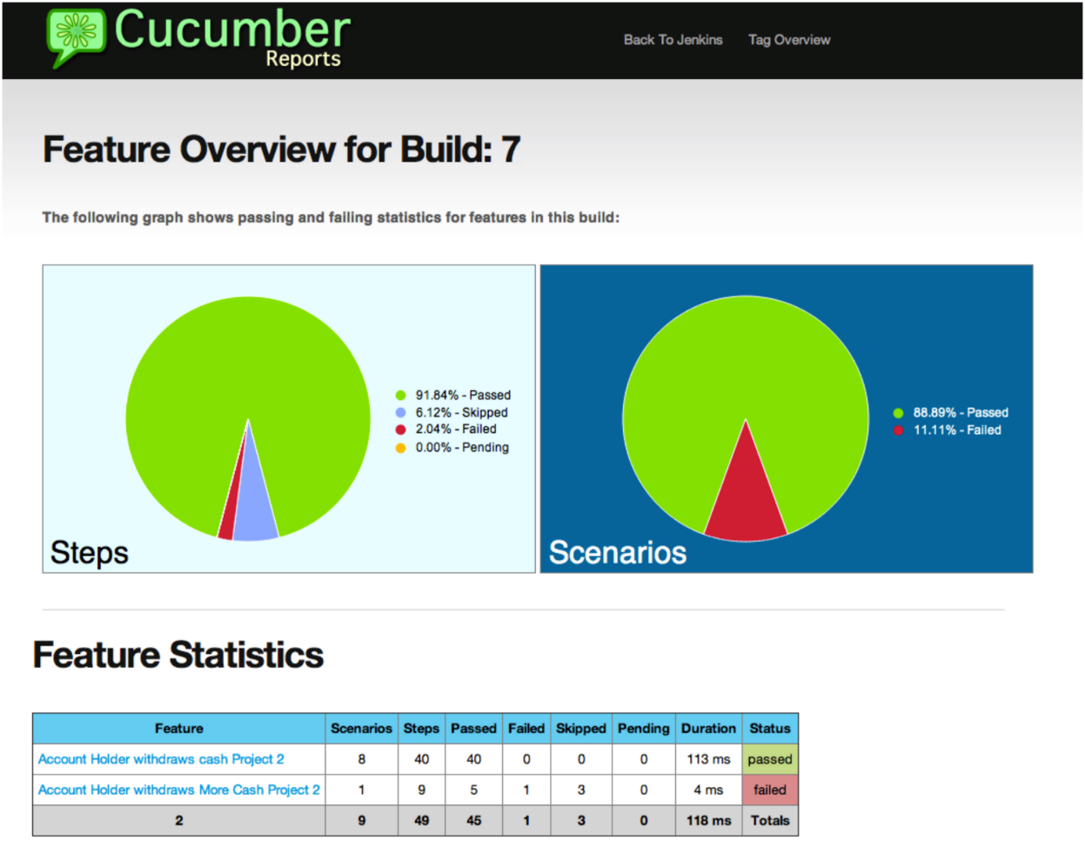
Cucumber Reports
https://github.com/jenkinsci/cucumber-reports-plugin

Slide 31
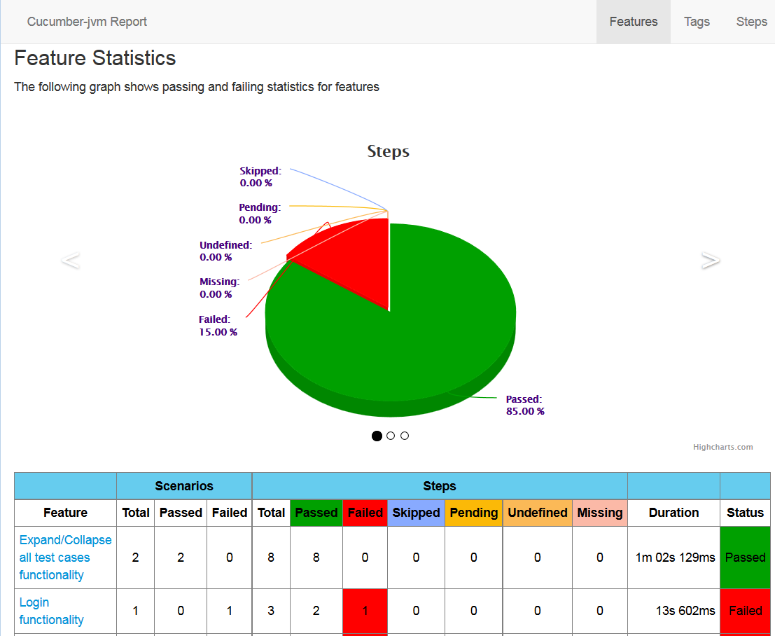
Cucumber-JVM Report
https://github.com/damianszczepanik/cucumber-reporting

Slide 32
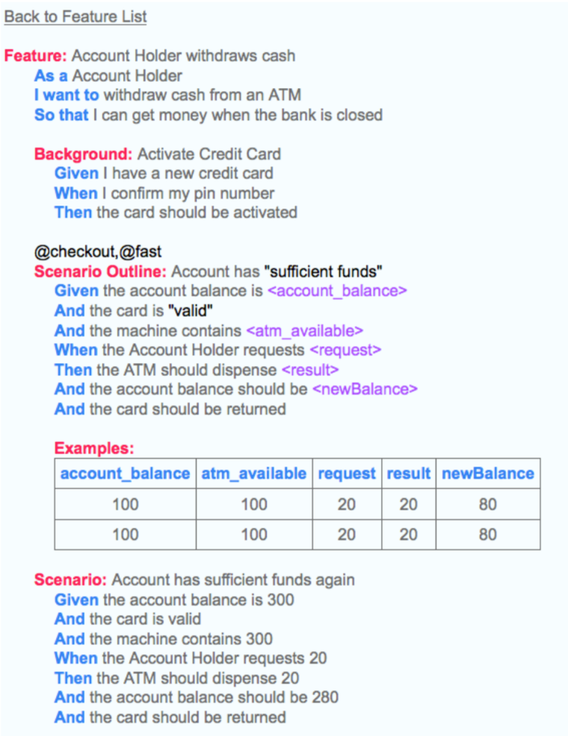
Live Documentation
https://github.com/kingsleyh/gherka

Slide 33
Resources
http://en.wikipedia.org/wiki/Behavior-driven_development;
http://behaviour-driven.org/Introduction;
http://docs.seleniumhq.org/docs/;
https://cucumber.io/docs/reference/jvm;
https://github.com/cucumber/cucumber/wiki/Tutorials-and-Related-Blog-Posts;

Slide 34

PROJECT OVERVIEW BY FIRSTNAME LASTNAME TITLE
Thank You!
Sergiy Kaliberda
Sergiy_kaliberda@epam.com

